Slide 1
Seam closing
For closing the seam of a spiral screen for wet application

Slide 2
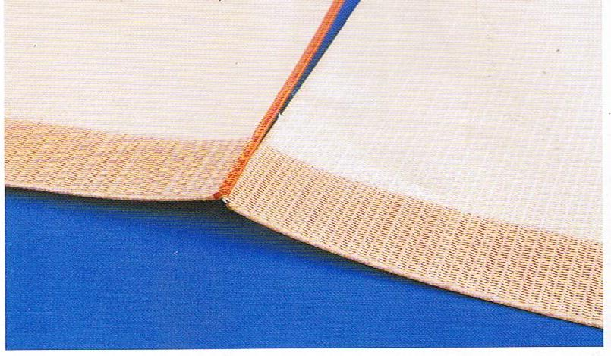
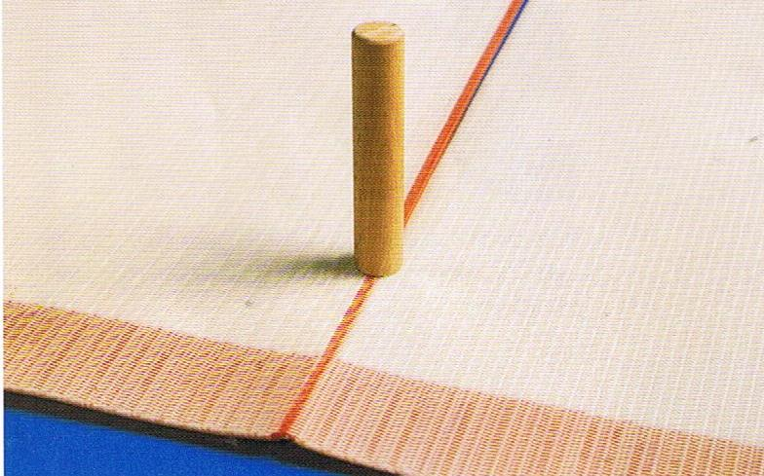
Installation requirements
1. Align both screen ends exactly and overlap the red spiral around 5 mm over the opposed spiral of the other end.
2. Assemble the spirals with round timber
Warning: Care about that there are no “double spirals”

Slide 3
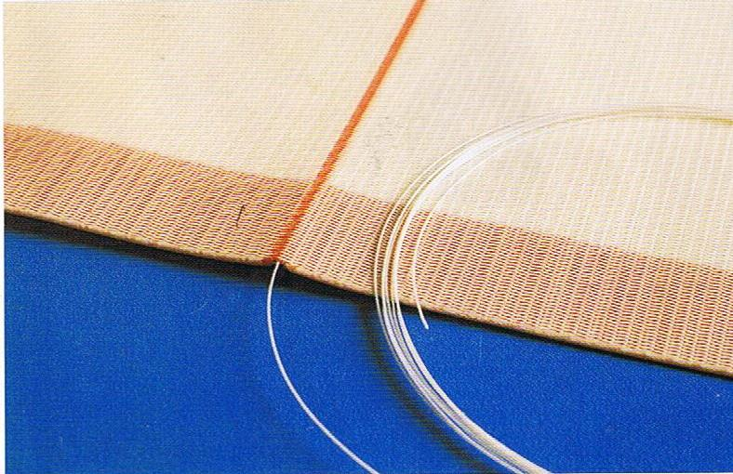
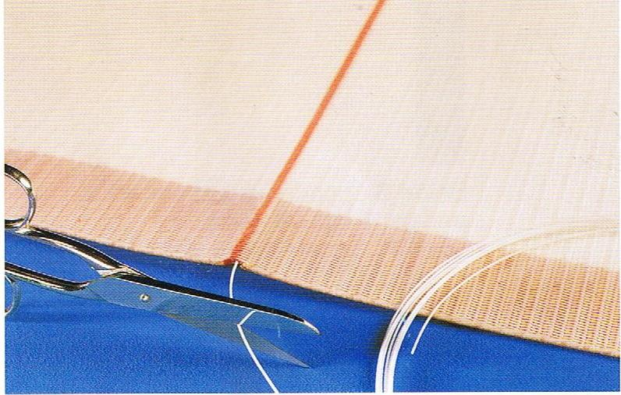
Installation requirements
3. Push the steel wire through the assembled spirals.
4. After joining cut both ends of the seam pintle approx. 10 cm from the screen edge.

Slide 4
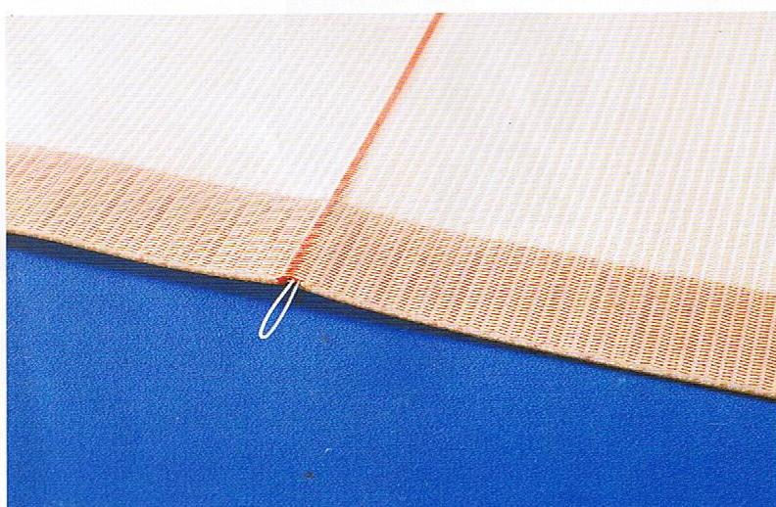
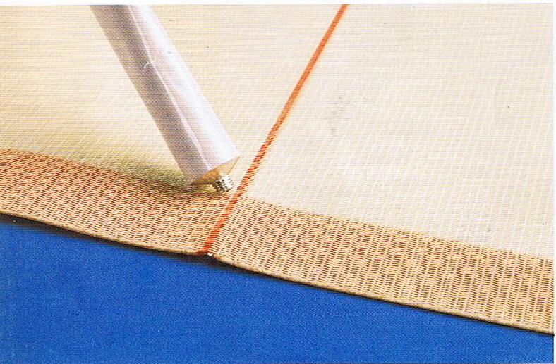
Installation requirements
Push the pintle wire ends back in the spirals beside the seam pintle
Fill the edges of the seam area with the enclosed glue

