Slide 1
Seam closing
Guidelines for safe and quick draw-in of spiral screens with Velcro fasteners

Slide 2
Basic requirements for successful installation of the screen
The installation will run smoothly if the seam will be closed on a clean and flat surface. It is recommend placing a piece of cardboard underneath. The seam area should be free of tension.

Slide 3
Installation requirements
1. Connect the forerunner to the old screen and pull the new screen into the machine
2. Fix the screen with clamps on both sides to avoid falling down. The clamps should be attached inside the screen as much as possible

Slide 4
Installation requirements
3. When aligning the screen make sure that the ends are parallel and on the same level
4. When closing the velcro fastener please make sure that the seam area has no tension

Slide 5
Installation requirements
5. Use the round timber of the supplied seam closing kit to close the seam. Care about to avoid “double spirals”. The seam should look just like the entire screen

Slide 6
Installation requirements
Correct interlocking of the WSF spiral seam:
Please make sure that the interlocked seam spirals look just like all the other spirals in the remaining area of the screen
False interlocking of the seam:
Too much overlapping with twisted and wrong aligned spirals. The seam does not look like the rest of the screen.

Slide 7
Installation requirements
6. Push the steel pintle wire completely through the joined spirals
7. Pull the connected plastic pintle wire slowly through the seam

Slide 8
Installation requirements
8. In case it is a filled spiral fabric fill the spirals beside the seam with the supplied fillers to avoid an open area. Cut salient fillers
9. After joining cut also both ends of the seam pintle approx. 10 cm from the screen edge. Insert the ends back into the spirals

Slide 9
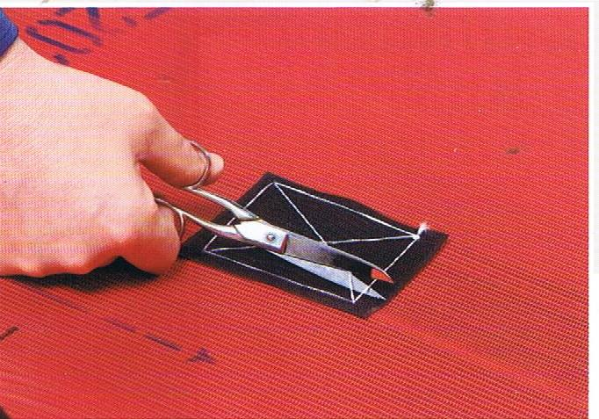
Installation requirements
10. Remove tools and assistant utilities from the screen
11. Use the enclosed adhesive to strengthen the edges and to fix the fillers. Now remove the clamps and check if all other additional parts are removed before tensioning the screen

